Slide 1
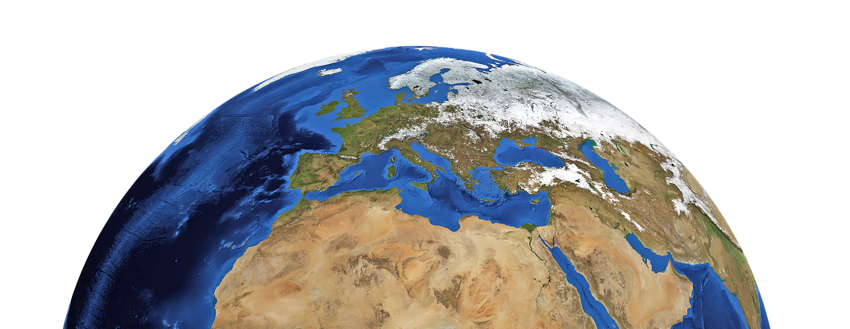
PRESENTED BY STELLIFY
Everything starts with water

Slide 2
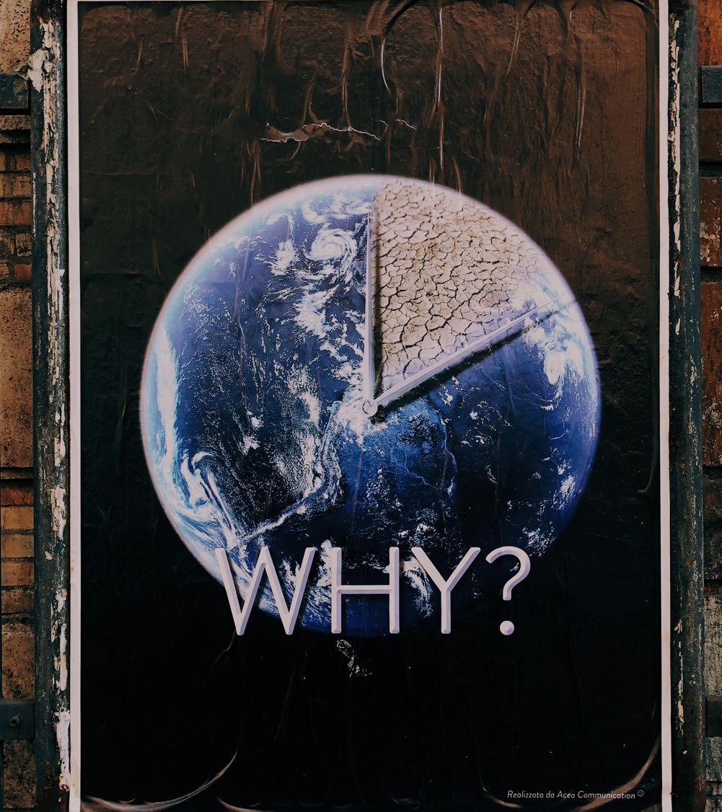
Why did we choose this challenge?
- Water is one of the most important resources on planet Earth and its efficient use is critical for sustainable development.
- We want to draw attention to the problems associated with freshwater, such as pollution, resource scarcity and declining quality of water bodies.
- Our goal is to raise awareness of the importance of freshwater conservation and to engage people and organizations in taking action to protect it.

Slide 3
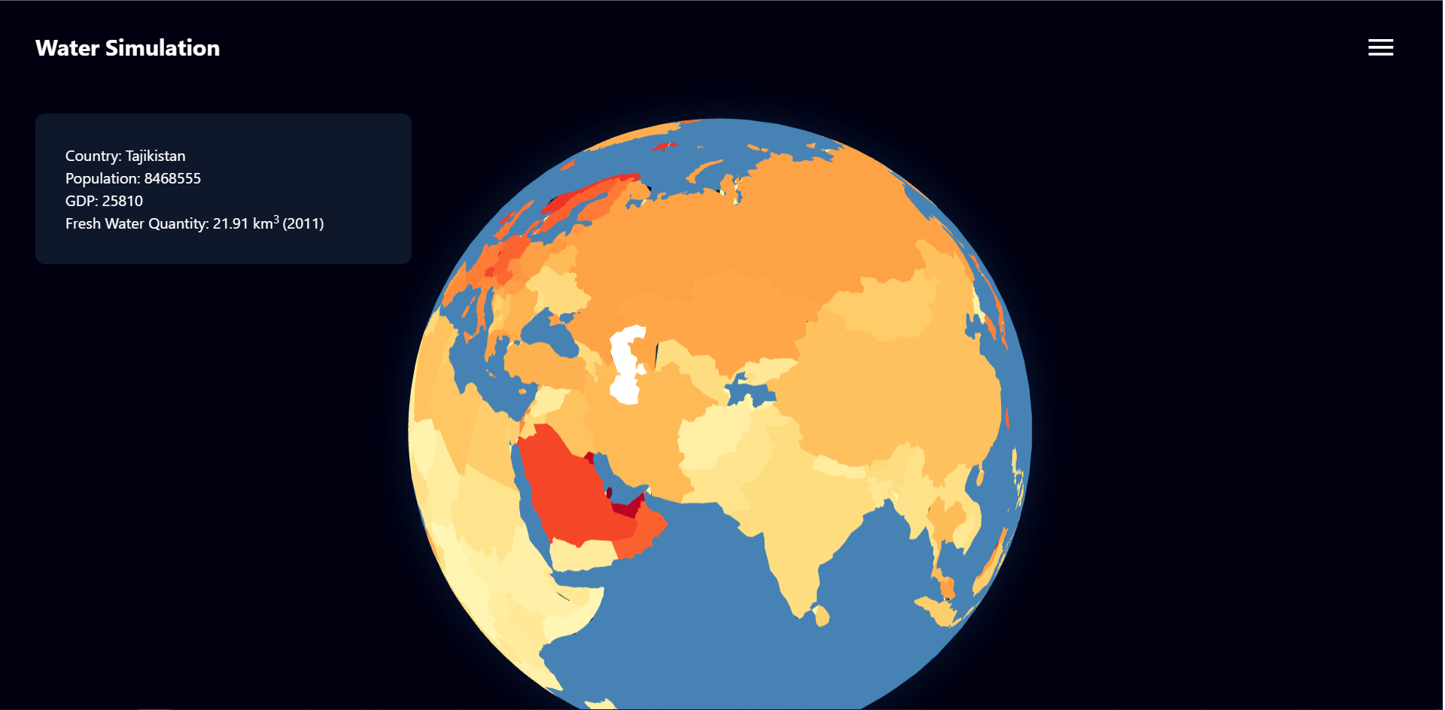
What we are doing on the task?
- Our project is a simulator of fresh water on planet Earth that models the behavior of water under different conditions.
- We use the geographical coordinates of water realizing the user, and with our simulator we can see how these properties can change under different factors, the effect of climate change on the amount of fresh water in a country.
- Our goal is to enable users to experiment with water in a virtual environment and better understand the importance of maintaining its quality and availability.

Slide 4
The essence of our project?
- "Everything starts with water" is a project that aims to raise awareness about fresh water and to find innovative solutions for the conservation and utilization of this resource.
- We offer an interactive environment where users can explore and experiment with water to better understand how their actions can affect the quality and quantity of freshwater available.
- Our goal is to engage and inspire people, organizations and governments to take action to protect freshwater and promote its sustainable use

Slide 5
I'm happy to present "Everything starts with water", a project I created as part of the NASA Space Apps Challenge organized by American Space Dushanbe.

